Slide 1
WHAT’S NEXT?
LAUNCHING YOUR JOB SEARCH
Julie Carroll
Outcomes Lead, Boston

Slide 2
LEARNING OBJECTIVES
WHAT’S NEXT
Establish expectations for GA’s post-course Outcomes support
Identify the GA job seeker expectations to actively job search & achieve an outcome
Create a sharable job-tracking system

Slide 3



THIS IS EXCITING!!
WHAT’S NEXT

Slide 4
WHAT’S NEXT
REVIEW:
GA OUTCOMES SUPPORT

Slide 5



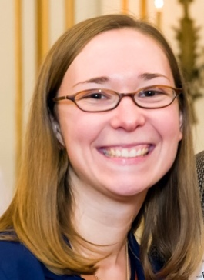
WHAT WE DO
Plus friendship!

Slide 6
GA OUTCOMES SUPPORT
CAREER COACHING SUPPORT
One-on-one Coaching availability
Individual strategy sessions, job offer decisions
Slack questions
Accountability partner
“Job Seeker Huddle” video calls - required
What tips can you share?

Slide 7
GA OUTCOMES SUPPORT
REFERRALS TO GA EMPLOYER NETWORK
Trello board
Keep accurate list of where you’ve applied on Trello
LinkedIn connections
Reach out if you’d like a connection

Slide 8
OUTCOMES EXPECTATIONS
BECOMING A JOB SEEKER
In order to qualify for Outcomes support, you’ll need to complete the following AND begin your job search immediately after graduation (2 week cutoff).
resume
digital presence: LinkedIn &
GA PrOFILE
Online
portfolio
shareable way of tracking job search
(Trello)
participation in All Outcomes Programming
& Surveys

Slide 9
OUTCOMES EXPECTATIONS
REMAINING AN ACTIVE SEEKER
Job seekers must fulfill these requirements to receive continued Outcomes support. Job seekers must begin these responsibilities immediately after graduation (2 week cutoff).
10+ job applications/wk
networking (2+ events/month)
daily updating of job search tracker + responsiveness
continued study and application of skills
presence in preferred market
(Strongly encouraged)
*These are GA’s expectations globally. Boston’s expectations are higher.

Slide 10
OUTCOMES EXPECTATIONS
VACATION POLICY
GA job seekers cannot take more than 30 days “off” – MAX!
The clock starts at graduation.

Slide 11
WHAT IS OUTCOMES
WHAT IS CONSIDERED AN OUTCOME?
An outcome is a paid opportunity to become an full-time employee, apprentice/intern, or freelancer in your field.
Freelance gigs and internships are considered an Outcome if they include at least one month of full-time, paid work.
*GA is currently able to support immersive graduates only through their first outcome.*

Slide 12
POST-COURSE COMMUNICATION
FAILURE TO MEET JOB-SEEKER EXPECTATIONS WILL RESULT IN A SUSPENSION OF OUTCOMES SUPPORT.

Slide 13
WHAT’S NEXT
JOB SEEKER LEVEL: PRO

Slide 14
OUTCOMES EXPECTATIONS
BECOME AN A+ JOB SEEKER
DO:
DON’T:
25-40 HOURS
2+ NETWORKING EVENTS
2-3 NETWORKING 1:1s
10+ TAILORED APPLICATIONS
SKILL BUILDING
WAIT TO BE PERFECT
PAUSE YOUR SEARCH
FOCUS ON 1 COMPANY
*TAKE MORE THAN 30 DAYS OFF*

Slide 15
WHAT’S NEXT
ACTIVITY:
TYPICAL WEEK

Slide 16
WEEKLY JOB SEEKER EXPECTATIONS
ACTIVITY: WHAT DOES A TYPICAL WEEK LOOK LIKE?
Create a calendar for a typical week of full-time job-searching.
What will you accomplish morning vs. evening, Mon vs. Fri?
How many hours per week will you spend searching for jobs, applying for jobs, making networking connections, attending events, building your skills, etc.?
What other commitments are in your life?

Slide 17
WEEKLY JOB SEEKER EXPECTATIONS
TYPICAL CALENDAR: WEEK 2
Monday | Tuesday | Wednesday | Thursday | Friday
Cold Apps | Cold Apps | Cold Apps | Cold Apps | Portfolio
Cold Apps | Cold Apps | Cold Apps | Cold Apps | Info Interview
Cold Apps | Cold Apps | Outreach | Portfolio | Info Interview
Outreach | Outreach | Portfolio | Portfolio | Build skills
Outreach | Outreach | Portfolio | Info Interview | Build skills
Portfolio | Info Interview | Build skills | Info Interview | Build skills
Portfolio | Build skills | Build skills | Build skills | Build skills
Event |  | Event
Event |  | Event
Event

Slide 18
WEEKLY JOB SEEKER EXPECTATIONS
TYPICAL CALENDAR: WEEK 7
Monday | Tuesday | Wednesday | Thursday | Friday
Cold Apps | Cold Apps | Cold Apps | Cold Apps | Cold Apps
Outreach | Outreach | Outreach | Interview | Info Interview
Prep - interview | Outreach | Outreach | Interview | Info Interview
Prep - interview | Info Interview | Prep - interview | Info Interview | Build skills
Interview | Info Interview | Prep - interview | Info Interview | Build skills
Interview | Build skills | Prep - interview | Build skills | Build skills
Interview | Build skills | Build skills | Build skills | Build skills
 | Event |  | Event
 | Event |  | Event
 | Event

Slide 19
WHAT’S NEXT
THE FUNNEL

Slide 20
THE FUNNEL
Managing a job search is like managing a sales funnel

Slide 21
WHAT’S NEXT
OUTCOMES JOB-SEEKER SURVEY

Slide 22
WHAT’S NEXT
TRELLO

Slide 23
TRELLO
How do I do it?
Go to: https://trello.com/b/JZIPAi2v
Click on “Show Menu” in top right corner
Click on “… More”
Click on “Copy Board”
Rename the board, e.g. “Lisa Mackin Job Tracker”
Add Members → JulieCarroll5
*Weekly Summaries due Fridays at 10am*

Slide 24
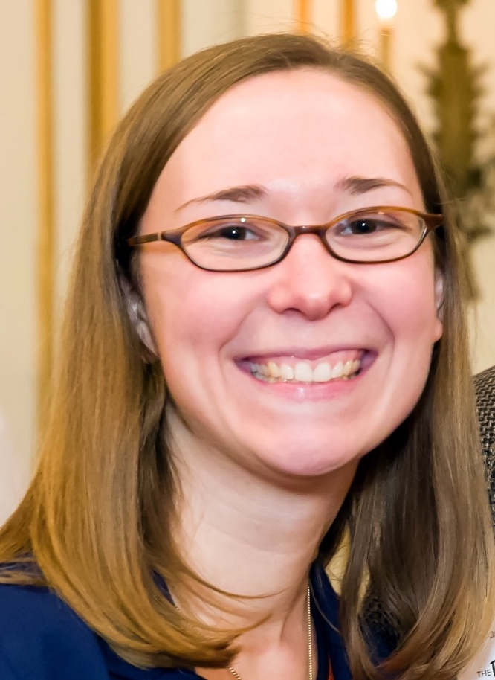
HI! WE’ve MET!
Friendship!
Email, Call, SLACK, or Text Me.
Julie Carroll, Outcomes Lead, Boston
julie.carroll@ga.co • www.linkedin.com/in/juliecarroll2
617-294-9022 • @JuliesTheBest
Notes:
Why I work at GA – I recently went through a job search.

Slide 25
WHAT’S NEXT
FINAL THOUGHTS

Slide 26
ReLAx. WE’re in this together.
Final ThougHts
#toughlove is still love

